Slide 1

Seminar Presentation on Text Recognition from Image
Submitted to
Dr. Megha Gupta
Submitted by
Hitesh Soni
PIET16CE038

Slide 2
Introduction
Today the most information is available either on paper or in the form of images.
Large information is stored in images.
Thus, there is a need for a system to extract text from general backgrounds.
Text Extraction and recognition in Images has become a potential application in many fields like Image indexing , Robotics, Intelligent transport systems etc.
For example capturing license plate information through a video camera and extracting license number in traffic signals.

Slide 3
However, variations of text due to differences in size, style, orientation, and alignment, as well as low image contrast and complex background make the problem of automatic text extraction extremely challenging.
Image content can be divided into two main categories:
1) Perceptual content
Perceptual content includes attributes such as Color , intensity, shape, texture, and their temporal changes.
2) Semantic content
Semantic content means objects, events, and their relations. Studies on semantic image content in the form of text, face, vehicle, and human action have also attracted some recent interest.

Slide 4
Among them, text within an image is of particular interest as
(i) It is very useful for describing the contents of an image.
(ii)It can be easily extracted compared to other semantic contents,
(iii)It enables applications such as keyword-based image search, and text-based image indexing.
We are using Convolutional Neural Network (CNN) that is a specific type of artificial neural network that uses perceptron's, a machine learning unit algorithm, for supervised learning, to analyze data i.e. text.
CNN is apply to image processing, natural language processing.

Slide 5
Aim & Objective
Input Image
Segmentation -
Separate the text region into its individual characters.
Recognition -
Recognize each of the character in the detected text region using a suitable algorithm
The aim of this project is to detect, extract and recognize text from images.
e.g.- license car plate.

Slide 6
Text Recognition Process
Insert Image which contains Expression
Image Pre-processing
Character Segmentation
Storing all character in single variable
Character Classifier
Feature Extraction & Normalization

Slide 7
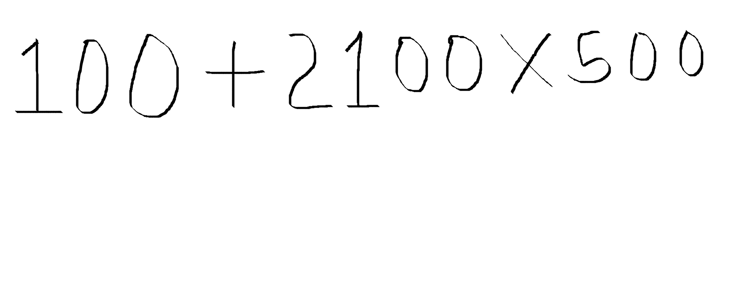






Result (from Project)
1050100
100+2100*500

Slide 8
Related Work
Various methods have been proposed in the past for detection and localization of text in images and videos.
These approaches take into consideration different properties related to text in an image such as color, intensity, connected-components, edges etc.
These properties are used to distinguish text regions from their background and/or other regions within the image.
In the algorithm based on color clustering, the input image is first pre-processed to remove any noise if present.
Then the image is grouped into different color layers and a gray component.
This approach utilizes the fact that usually the color data in text characters is different from the color data in the background.

Slide 9
Scope of Text Recognition
Text Recognition is used in our project for recognising the digit, operators that is further used for solving the expressions.
Text detection and recognition in general have quite a lot of relevant application for automatic indexing or information retrieval such document indexing, content-based image retrieval, and license car plate recognition which further opens up the possibility for more improved and advanced systems.
It is also used for parking validation and car rental with the help of extracting registration number of vehicle from license car plate.

Slide 10
Thank You

